Slide 1
Data Base -SQL
by Satish T

Slide 2
What is Data Base
A database is an organized collection of structured information, or data, typically stored electronically in a computer system. A database is an organized collection of data, easily accessed and managed.
Data and information?(Data refers to the raw information.)
Data is a collection of a distinct small unit of information. It can be used in a variety of forms like text, numbers, media, bytes,

Slide 3
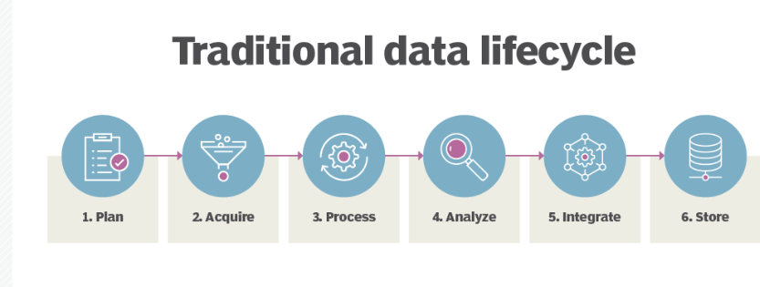
How data Generated
Converting data to information
Data and information are not the same. Data refers to numerical and qualitative observations
Information is created when data is presented in a way that has meaning to the recipient.
Different types of Data bases
1.Centralized Database
2.Distributed Database
3.Relational Database
4.Cloud Database
5.NoSQL

Slide 4
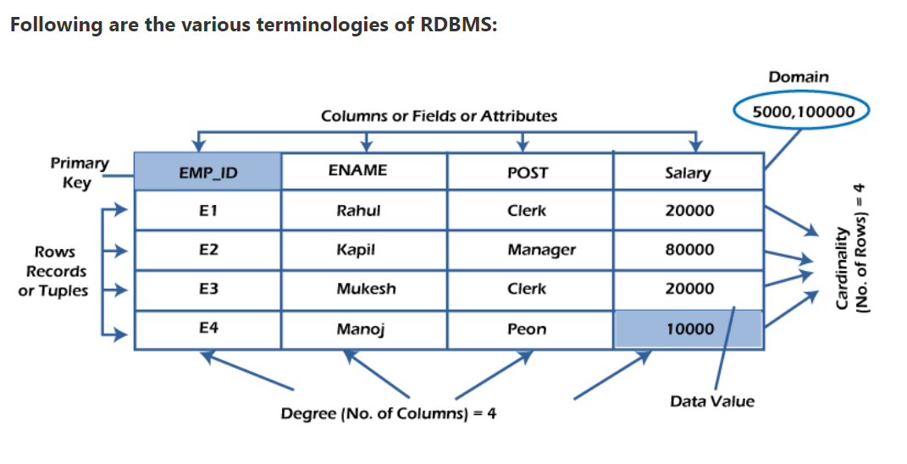
RDBMS
DBMS Architecture
1-Tier Architecture
2-Tier Architecture
3-Tier Architecture
RDBMS stands for Relational Database Management System.(it is based on the relational model introduced by E.F. Codd.)
Keys:
unique:
NOT NULL
Primary key: key used to identify one and only one instance of an entity uniquely.
Forign key: Foreign keys are the column of the table used to point to the primary key of another table.

Slide 5
SQL
Introduction to SQL
SQL is a tool for organizing, managing, and retrieving archived data from a computer database.
Advantages and Disadvantages of SQL

Slide 6
SQL Data types
Varchar
Varchar2
Number
Blob
Date
Timestamp
float

Slide 7
SQL
Data definition: It is used to define the structure and organization of the stored data and the relationships among the stored data items.
Data retrieval: SQL can also be used for data retrieval.
Data manipulation: If the user wants to add new data, remove data, or modifying in existing data then SQL provides this facility also.

Slide 8
Access control: SQL can be used to restrict a user’s ability to retrieve, add, and modify data, protecting stored data against unauthorized access.
Data sharing: SQL is used to coordinate data sharing by concurrent users, ensuring that changes made by one user do not inadvertently wipe out changes made at nearly the same time by another user.

Slide 9
SQL Rules
‘;’ is used to end SQL statements.
Statements may be split across lines, but keywords may not.
Identifiers, operator names, and literals are separated by one or more spaces or other delimiters.
A comma (,) separates parameters without a clause.
Comments may be enclosed between /* and */ symbols and maybe multi-line.

Slide 10
SQL Rules
Identifiers can contain up to 30 characters.
Identifiers must start with an alphabetic character.
Characters and date literals must be enclosed within single quotes.
A space separates a clause.
Reserved words cannot be used as identifiers unless enclosed with double quotes.
Numeric literals can be represented by simple values.

Slide 11
clauses
where
Group by
order by
Like,between
having (Agregate funcitons)
The HAVING clause was added to SQL because the WHERE keyword cannot be used with aggregate functions.
SELECT COUNT(CustomerID), Country
FROM Customers
GROUP BY Country
having COUNT(CustomerID) > 5;

Slide 12
Agregate funtions
Count()
Sum()
Avg()
Min()
Max()
select COUNT(*) FROM emp;

Slide 13
Sub Queries
The Subquery or Inner query is an SQL query placed inside another SQL query. It is embedded in the HAVING or WHERE clause of the SQL statements.
SELECT Column_Name1, Column_Name2, ...., Column_NameN
FROM Table_Name WHERE Column_Name Comparison_Operator
( SELECT Column_Name1, Column_Name2, ...., Column_NameN
FROM Table_Name WHERE condition;

Slide 14
SELECT statement,
UPDATE statement,
INSERT statement, and
DELETE statement.
SELECT * FROM Student_Details WHERE Stu_Marks> ( SELECT AVG(Stu_Marks ) FROM Student_Details);
INSERT INTO New_Employee SELECT * FROM Old_Employee WHERE Emp_Salary > 40000;

Slide 15
Commit and Auto commit
roll back

Slide 16
Views
Virtual Tables also have rows and columns similar to a real table in a database
Such views are simply made by selecting data(fields) from one or more tables, present in the database, with some conditions for selecting rows of the table.
A view is a virtual table whose contents are defined by a query. Like a table, a view consists of a set of named columns and rows of data.
Unless indexed, a view does not exist as a stored set of data values in a database.

Slide 17
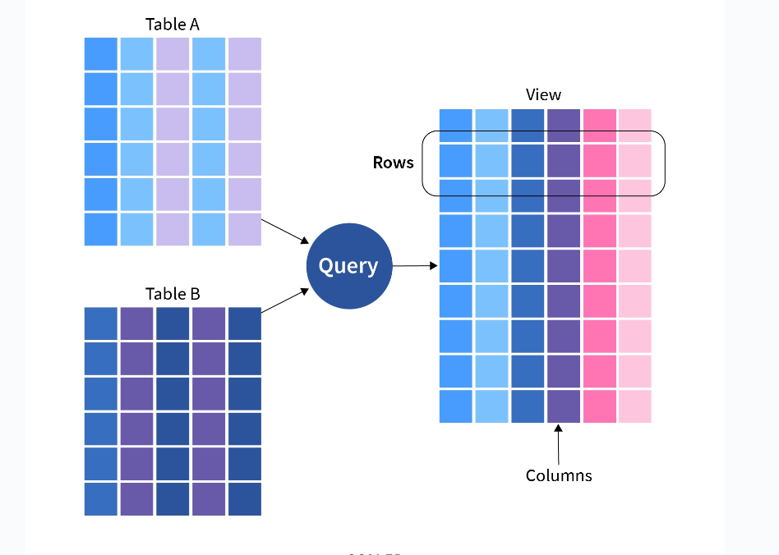

Slide 18
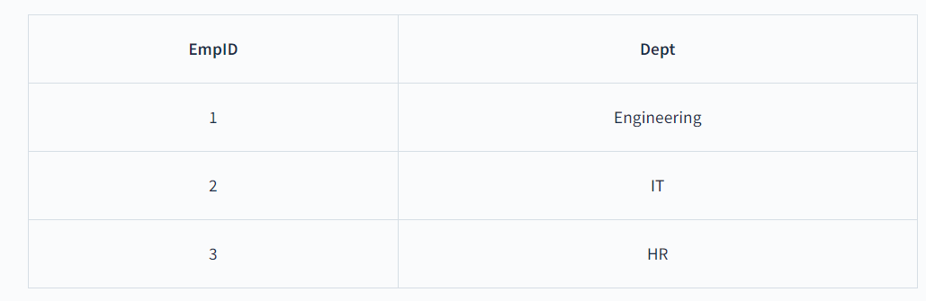
Example
In this example, we are creating a view table from EmpRole Table for getting the EmpID and Dept for employees having EmpIDs less than 4. So the query will be:
CREATE VIEW EmpView2 AS
SELECT EmpID, Dept FROM EmpRole WHERE EmpID<4;
Now to see the data in the EmpView2 view created by us, We have to simply use the SELECT statement.
SELECT * from EmpView2;
Output: The view table EmpView2 that we have created from EmpRole Table contains EmpID and Dept as its data fields.

Slide 19
Joins
INNER JOINS
An inner join between two tables will return only records where a joining field, such as a key, finds a match in both tables.
INNER JOIN join ON one field

Slide 20
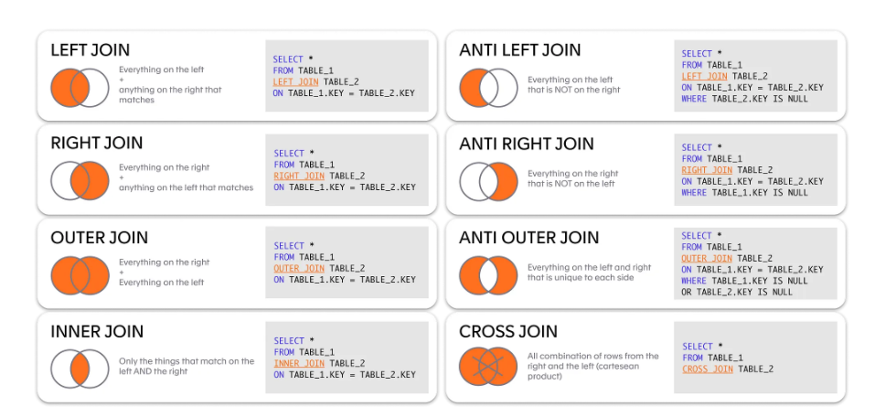

Slide 21
Thanks.

